Slide 1
Optimal Matrix Multiplication
Paper by Stefano Gualandi
Implementation by Jean Berthaud

Slide 2
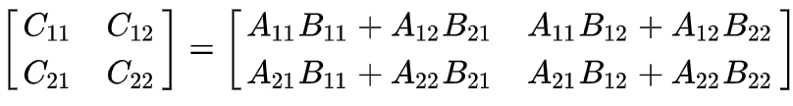
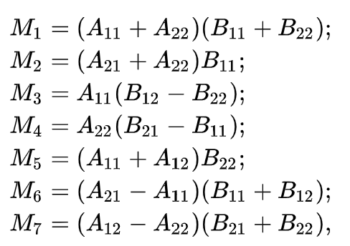
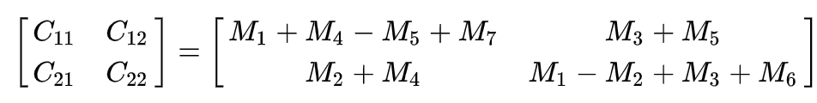
History
Naive algorithm :
Strassen algorithm :
Uses intermediary variables
Less mutliplications ! →

Slide 3
History
Structure of matrix multiplication
ILP
Implementation
results

Slide 4
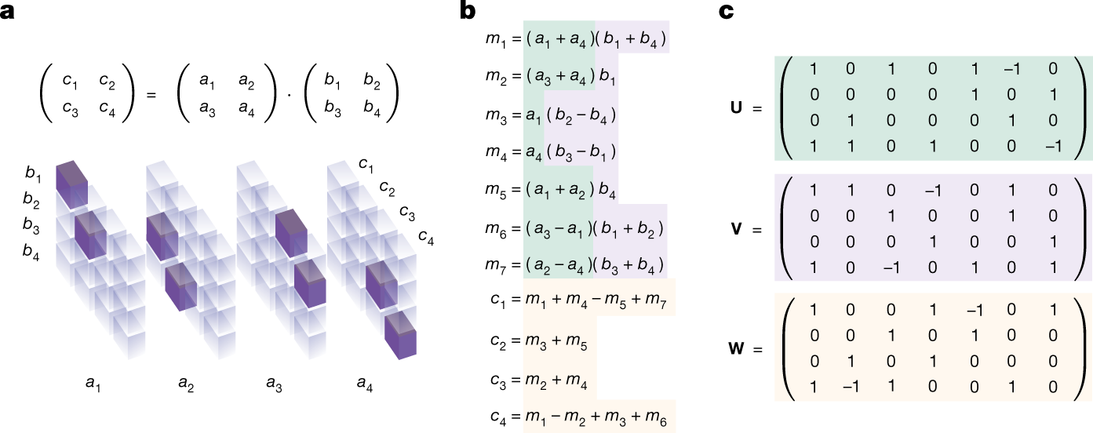
Matrix multiplication tensor, Strassen example

Slide 5
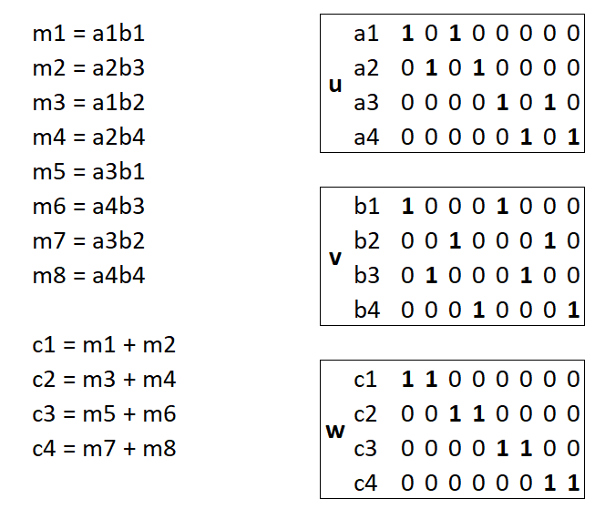
Matrix multiplication tensor, naive algorithm

Slide 6
ILP formulation : main constraint
The three tensors u, v and w are called α, β and γ
Whatever the intermediate M are for an algorithm, the value of Cij must be computed from the same multiplications as the naive algorithm.
Example with C2 :
Naive : m3 + m4 = a1b2 + a2b4
Strassen : m3 + m5 = a1(b2-b4) + (a1+a2)b4 = a1b2 + a2b4

Slide 7

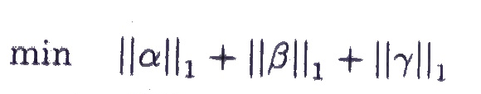
ILP formulation : objective function
Two possibilities :
We can fix the number of multiplications K, in this case we want to reduce the number of additions.
The number of additions is given by :
Indeed, => a1 + a4 → One addition
The objective function is then

Slide 8
ILP formulation : objective function
We can also start with K = n^3 as for the naive algorithm, and try to reduce the number of multiplication.
It’s possible with an objective function adding increasing weights to the sum of each columns.
For example with n=2, the sum of the first column will have a coeff of 1, and the sum of the last column will have a coefficient of 8.

Slide 9
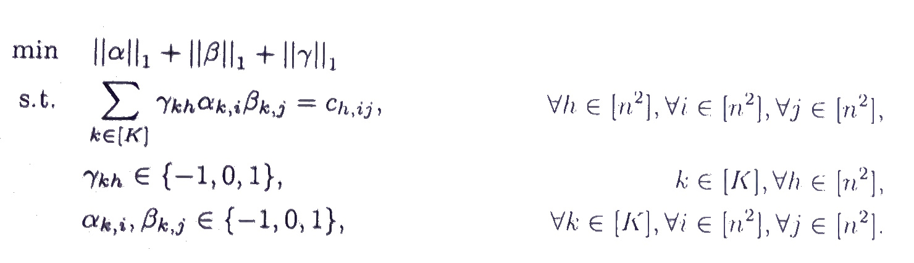
ILP formulation in full

Slide 10
Implementation
With Pyomo, solved by Gurobi. We must set the parameter "NonConvex" to 2.
Objective norm 1 : the absolute value is the square of the cell because cells are from {-1,0,1}.
Objective coefficients on the sum : we add a new variable that stores the sum, and use this new variable in the objective function.

Slide 11
Implementation
The naive algorithm is computed with numpy in a rank 3 tensor.
In order to have a quadratic constraint, the main constraint is split : the multiplication of each is aibj is stored in a new variable, and then used in the other constraint.
A function compares the multiplication of random matrices by the algorithm found and by numpy, if the result is identical it shows the result is correct.

Slide 12
Results
Using only binary variables, it can find the naive algorithm for square matrices with n=2 and n=3.
Using {-1,0,1} it can find the an algorithm for n=2. A time limit must be used, so it’s not necessarily the optimal number of additions possible.
Unfortunately it doesn’t find strassen algorithm in a reasonable amount of time.

